Slide 1
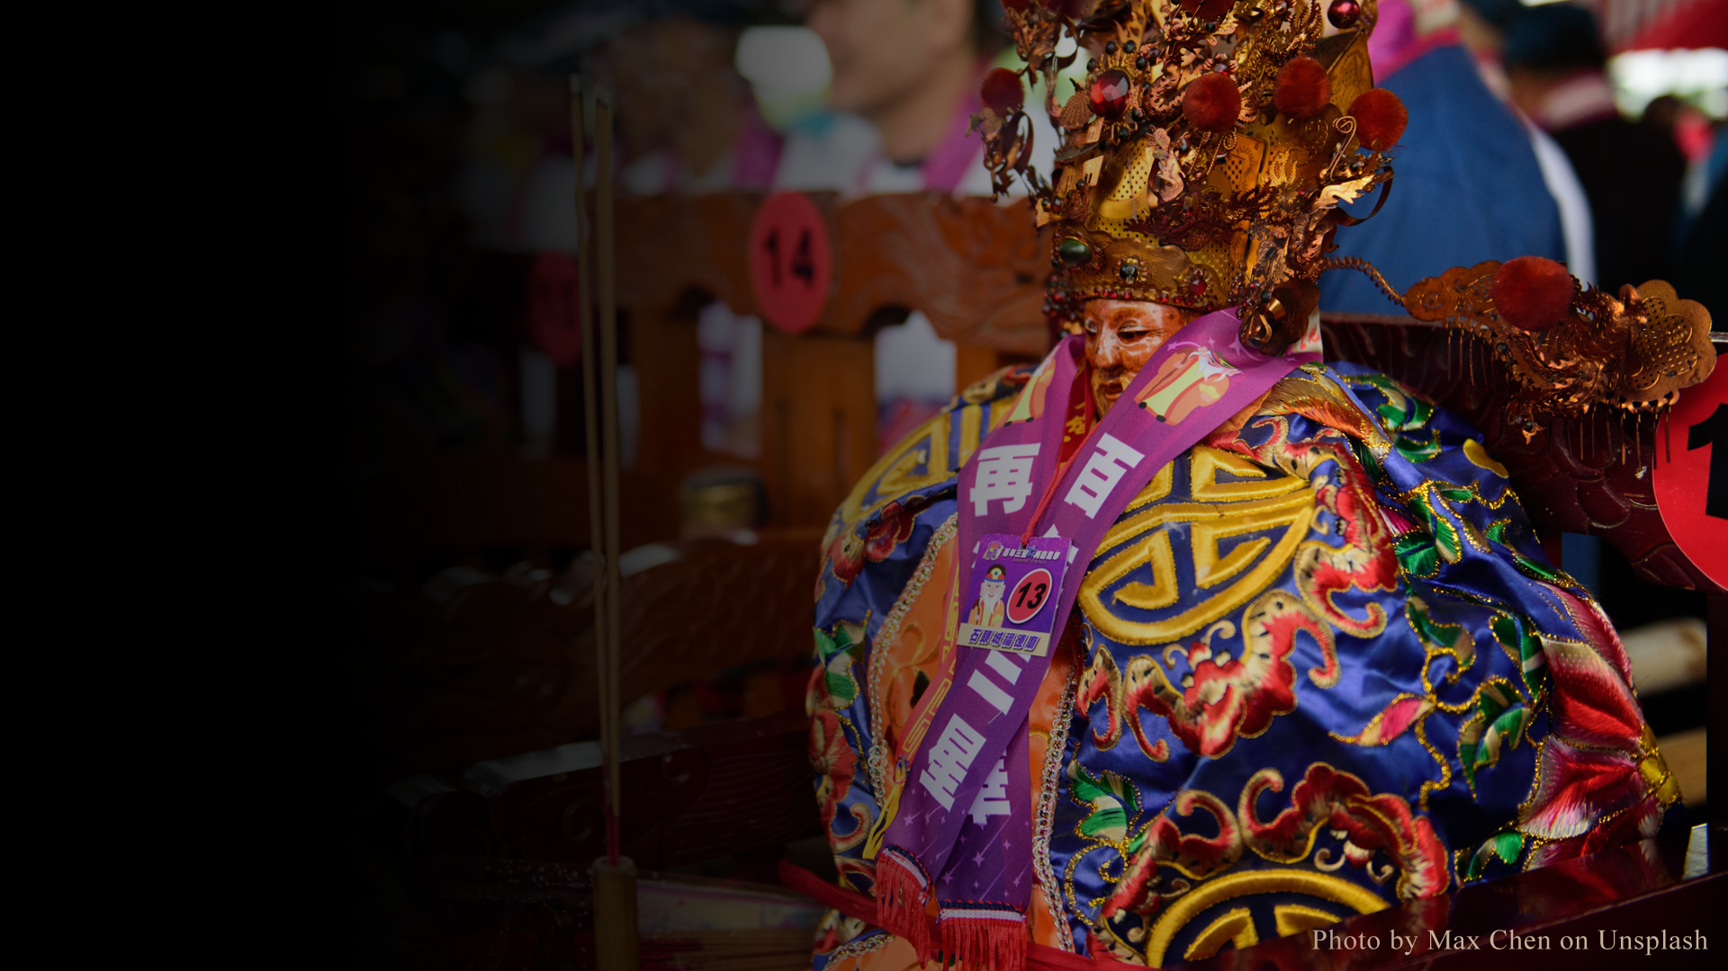
Understanding
Chinese Gods
Teaching material for A-level course on
Chinese Religions

Slide 2
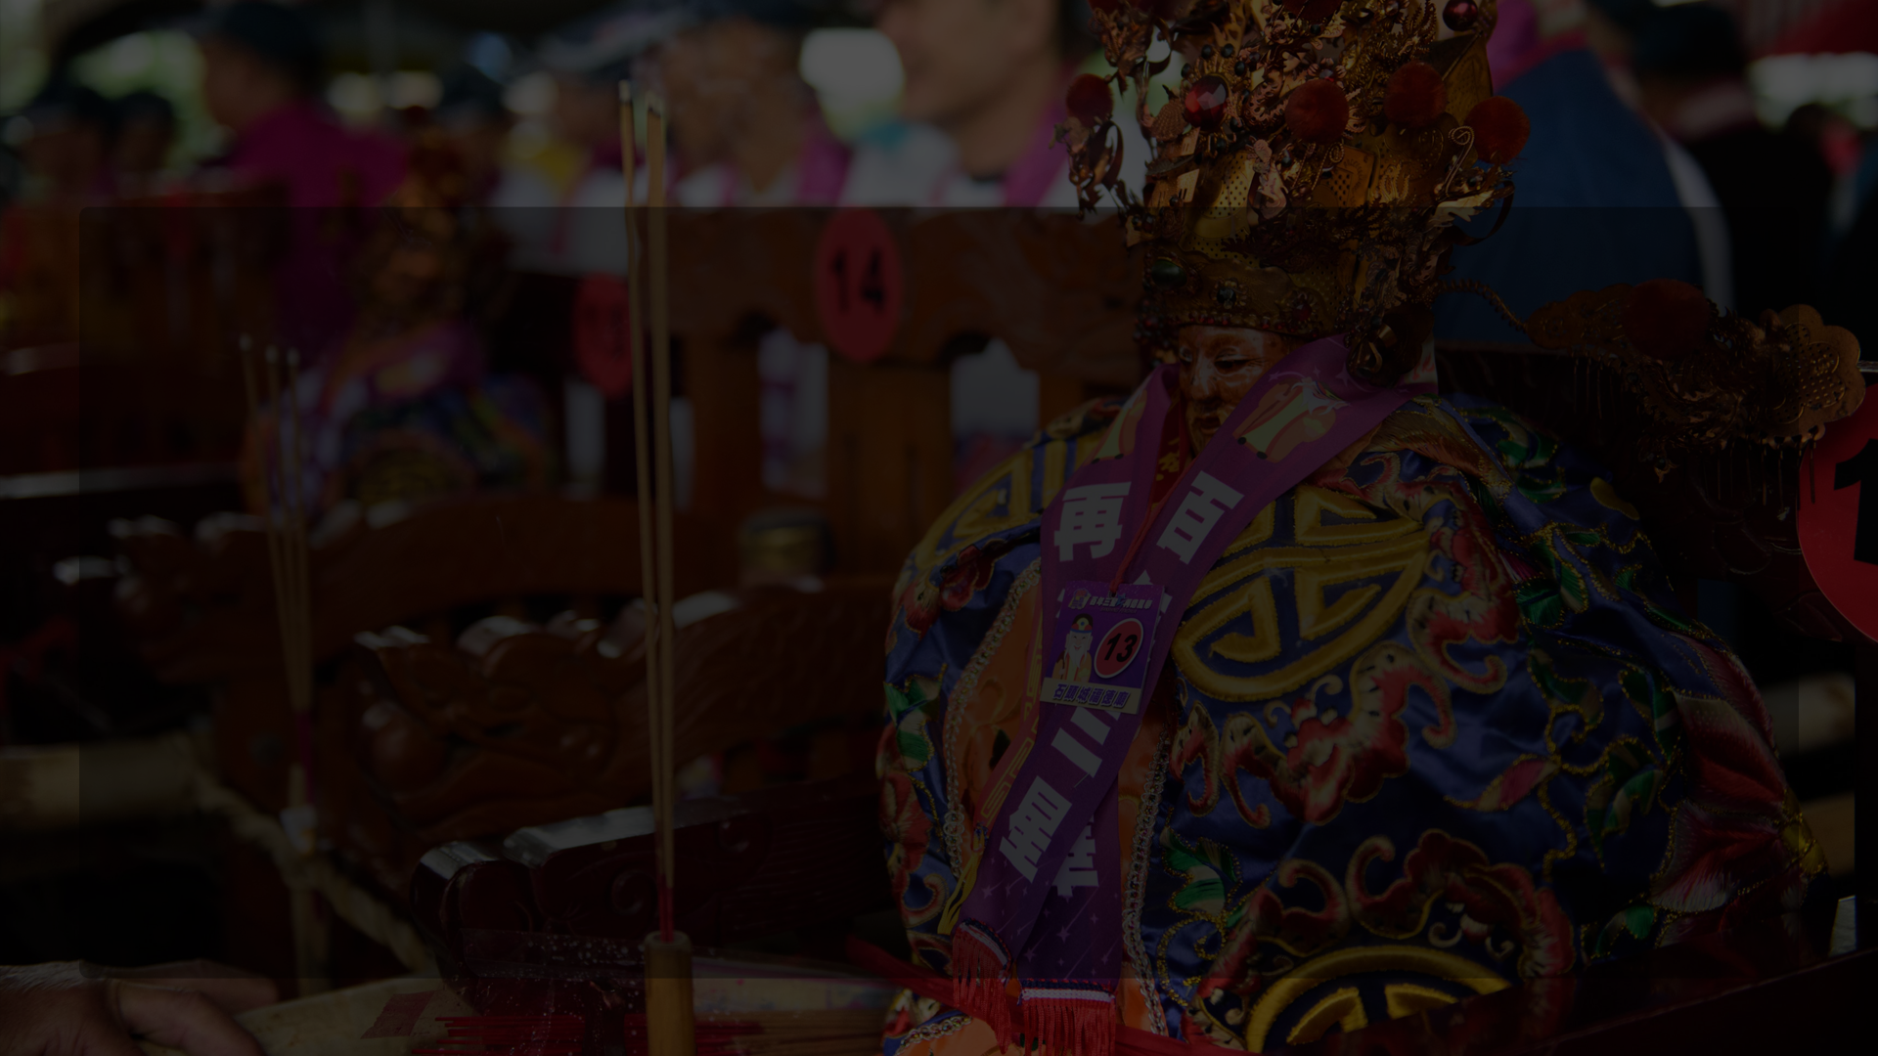
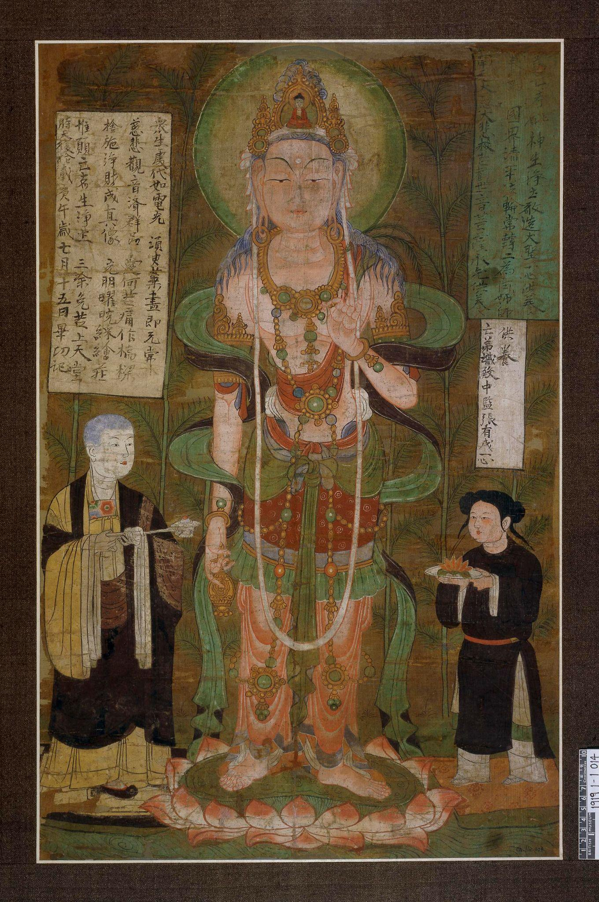
Gods in Ancient China
There are many gods and goddesses in Chinese religions. They play a wide range of roles that are related to human life. Many gods only show power in their local areas, whereas others can extend their power to other places. In such cases, they become regional or state-wide gods. Unlike Greek gods, Chinese gods are rarely family members with each other.
Avalokiteśvara (Guanyin 觀音, a localized Buddhist god), painting,
910 AD. Dunhuang, China, the British Museum (1919,0101,0.14)
© The Trustees of the British Museum (CC BY-NC-SA 4.0)

Slide 3
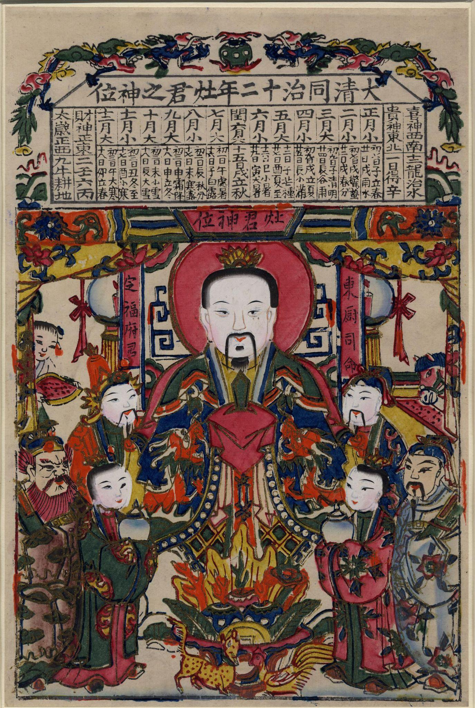
Well-known Chinese Gods and Their Roles
Door God: Guarding the entrance of a house.
Stove God: Protecting a household and overseeing people’s daily deeds.
Ancestral God: Overseeing the well-being and safety of a household generally.
God of Wealth: Giving wealth and prosperity.
Earth God: Ensuring the safety of a household or a neighbourhood.
Temple Guardian Gods: Protecting a particular temple.
City God: Ensuring the safety and order of a city.
Dragon God: Giving rain.
God of the Eastern Peak: Administering life, death, and underworld justice.
Stove God 竈君, woodblock print, 1873 AD. China, the British Museum
(1954,1113,0.6) © The Trustees of the British Museum (CC BY-NC-SA 4.0)

Slide 4
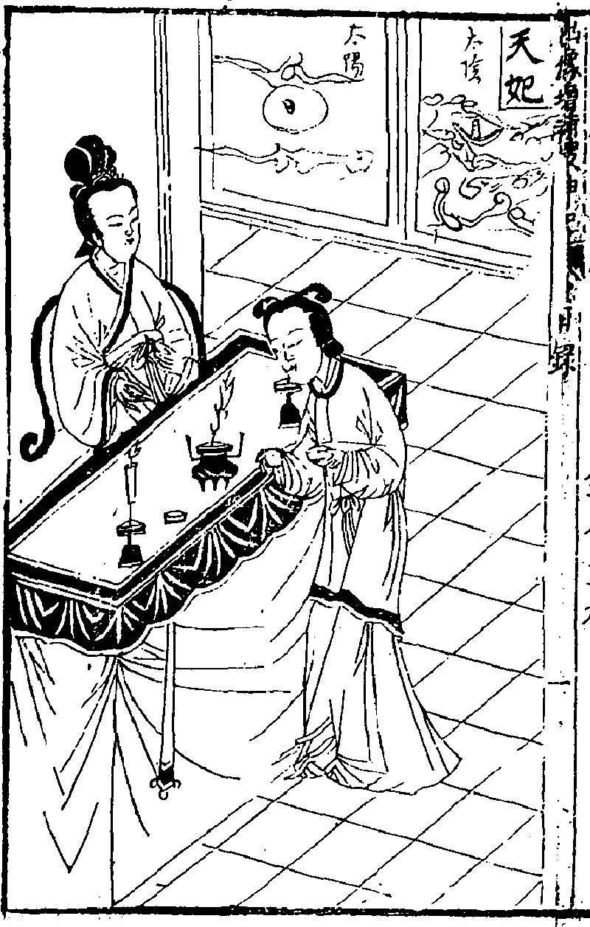
Emperor Guan: Also known as the God of War, who protects the state in military campaigns.
True Warrior: A stellar god who protects people’s safety and known to be holding a sword.
Wenchang: Helping with exams and official career.
Five Sinister Gods: A group of five gods doing both harm and good to people.
Guanyin: Well-known for her compassion, she offers cures, offspring, and other blessings.
Heavenly Consort: A goddess who offers safety in maritime travel in particular.
Jade Maiden: A goddess on the Eastern Peak, who gives offsprings and presides over human life and death.
Jade Emperor: The ruler of the gods; the top god in Chinese religions.
And many more…
Heavenly Consort 天妃 (Mazu 媽祖). Records of Seeking the Gods, New Edition with Portraits 新刻出像增補搜神記, author unknown, Fuchun tang imprint, late Ming dynasty. Digital copy shared by Chinese Text Project.

Slide 5
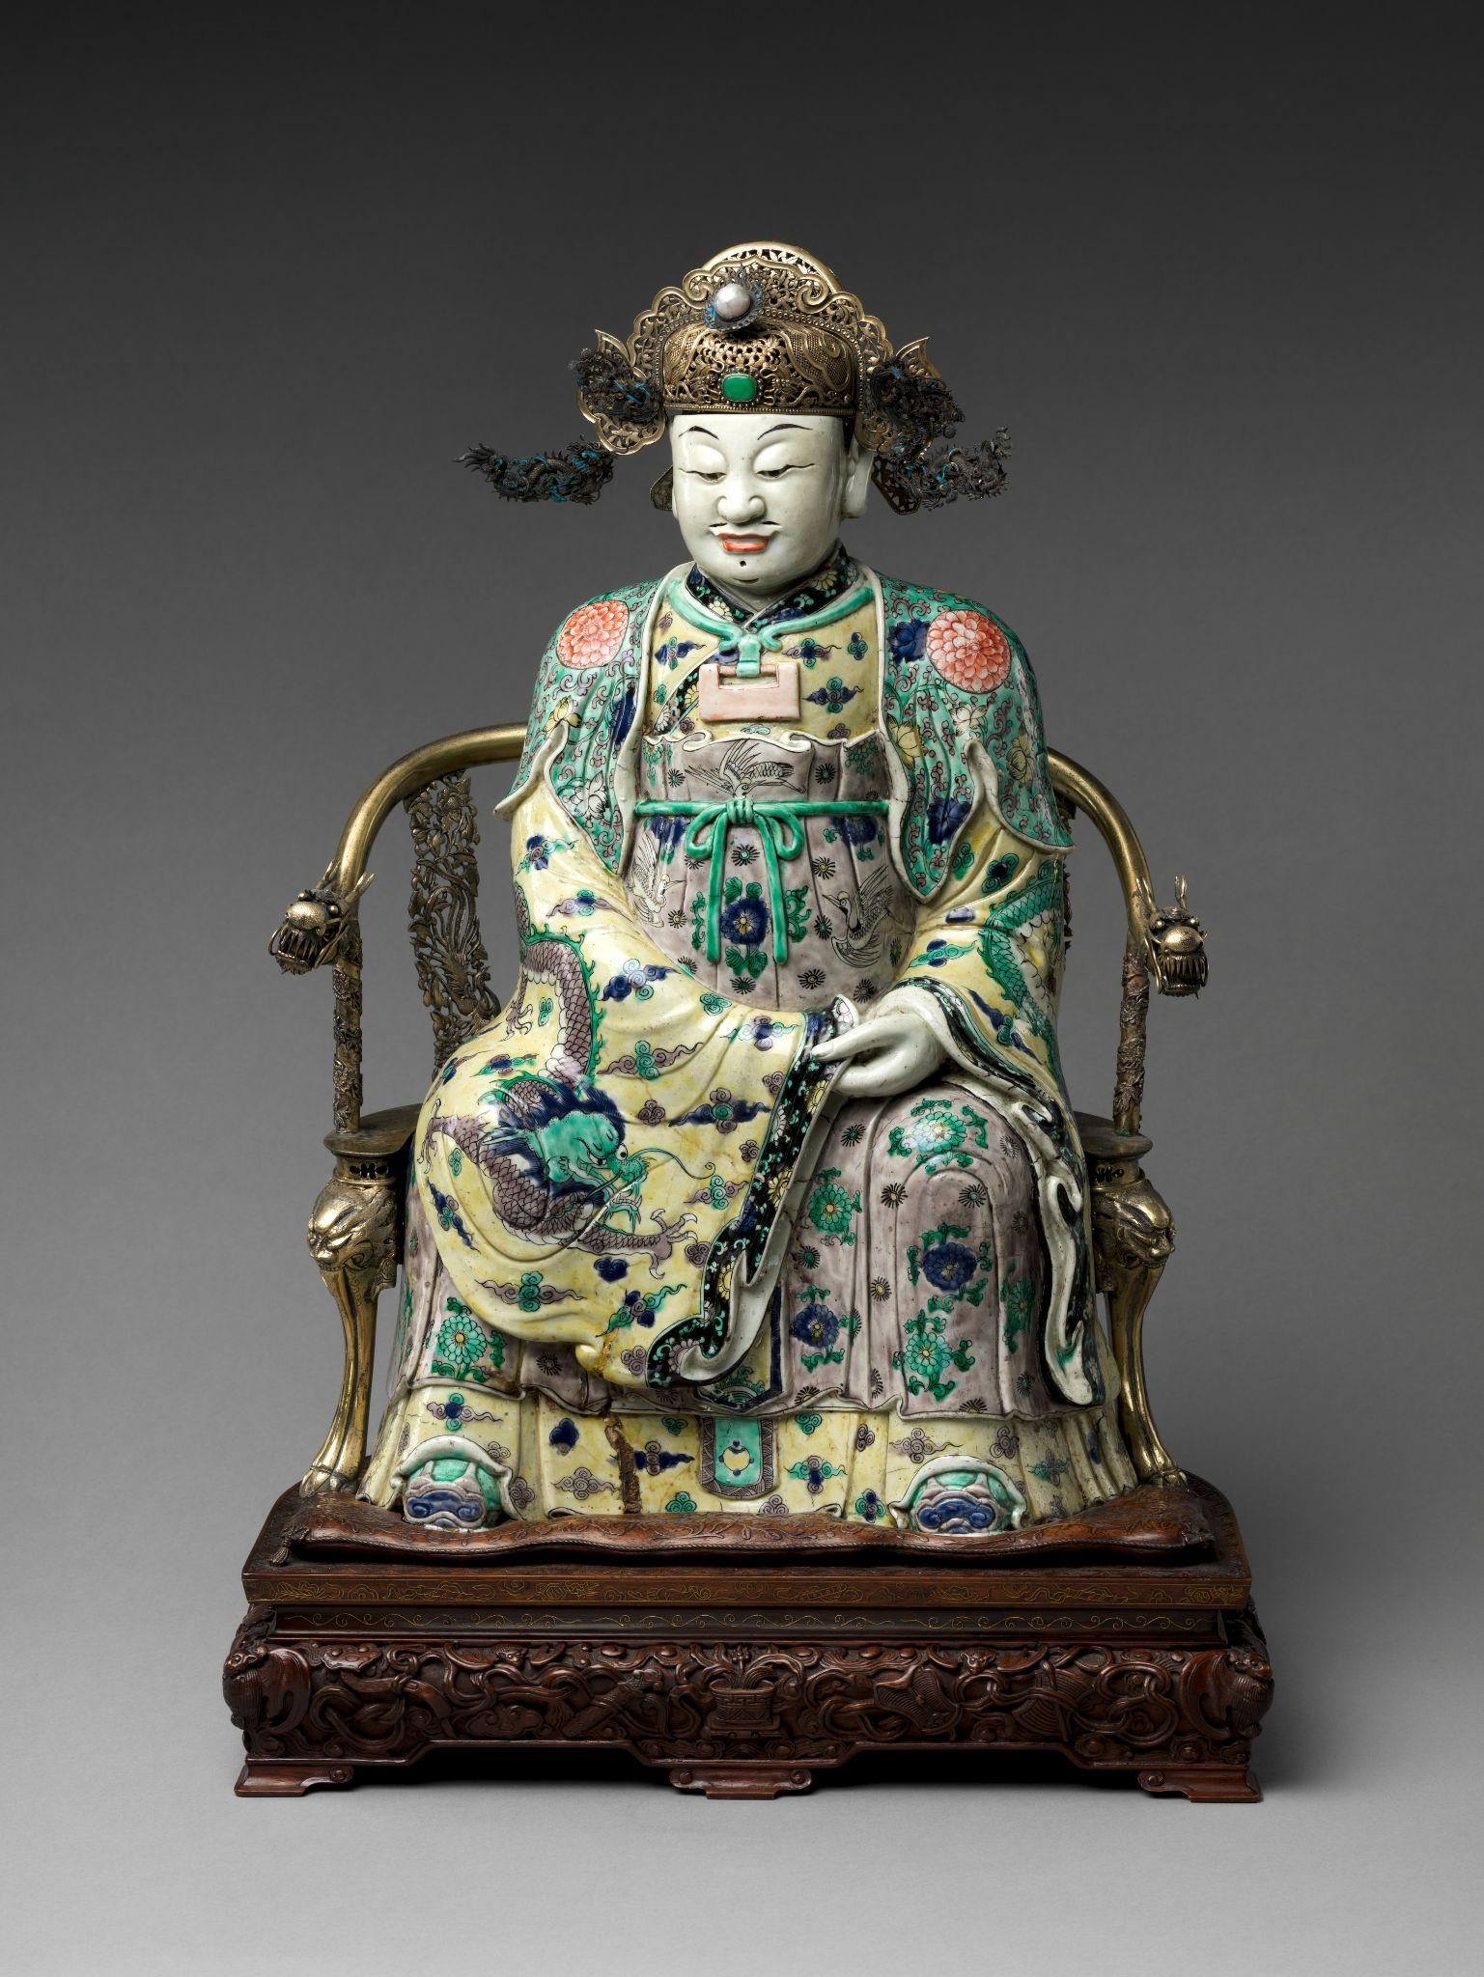
How People Choose
Their Gods
Specific life problems. Such as illness, safety, poverty, exam stress, etc.
A god’s expertise. Some gods are better at solving certain issues than others.
Physical distance. Local gods’ temples are easier to access than the temples of gods faraway.
Existing belief. One’s existing religious belief may limit one’s choice of gods.
Social relations. Family and friends may also influence one’s choice of gods.
The God of Wealth 財神, sculpture, 1662-1722 AD. China,
the MET Museum (61.200.11)

