Slide 1
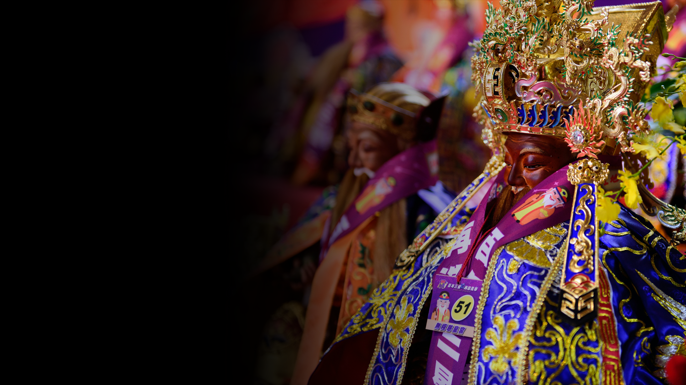
Divine Saving in
Chinese Religions
Teaching material for A-level course on
Chinese Religions

Slide 2
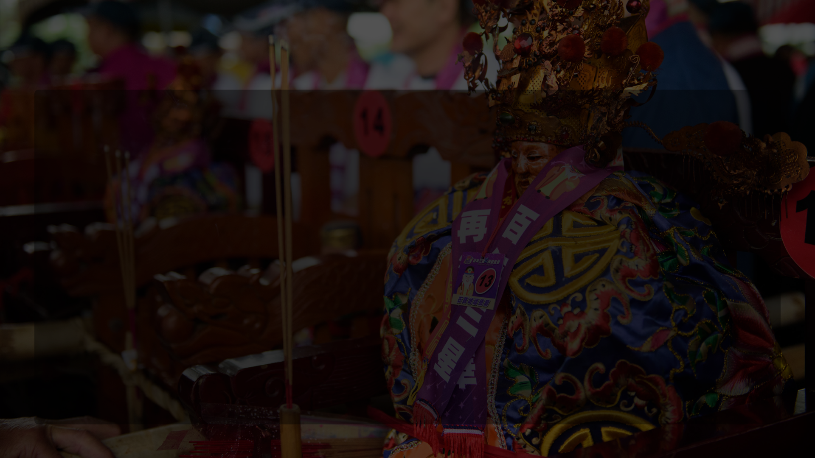
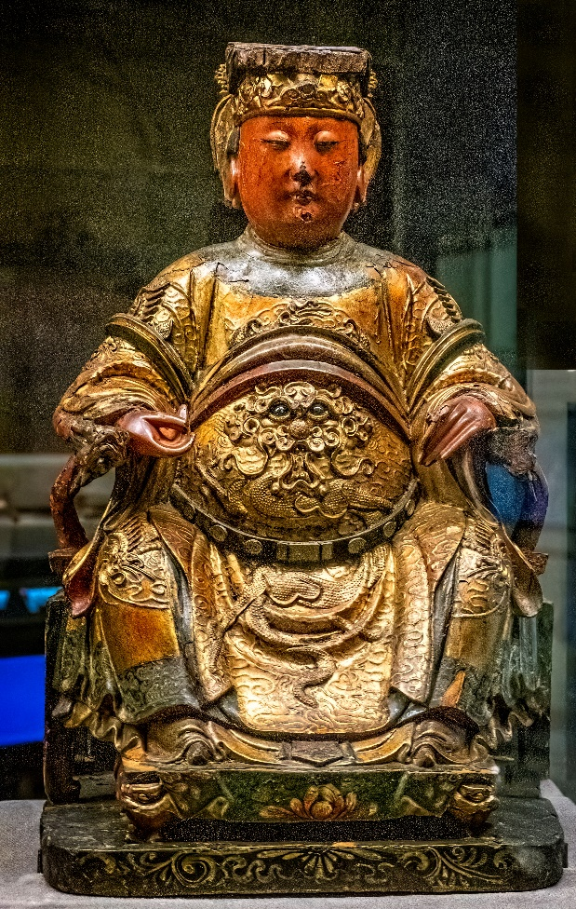
Chinese gods have the power to protect individuals and communities from dangers and crises. They generally have their special areas of competences, but different gods’ powers may overlap. Some gods may be more effective in certain areas than others. The following are the most common fields in which the gods help people.
A late 19th-century wooden statue of the Heavenly Consort
© Mary Harrsch, Wikipedia.com, under Creative Commons license 4.0.

Slide 3
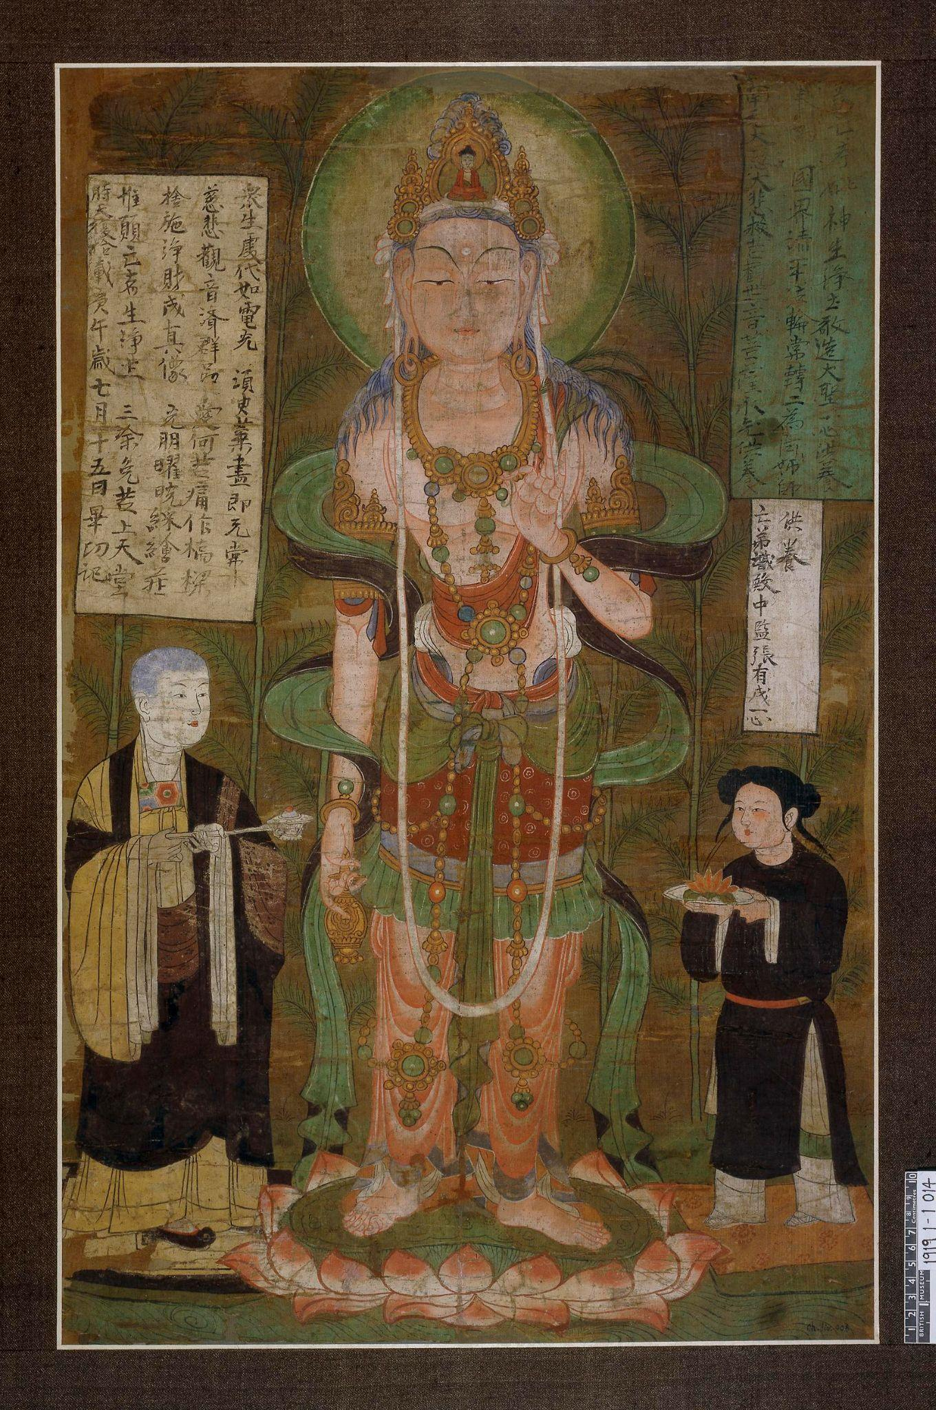
Fields of Divine Saving
Life issues:
  Health issues – illnesses, childbirth, and plagues.
  Safety issues – dangers on land and at sea, robbery, murder, riots, warfare, animal attacks, and other accidents.
  Natural disasters – droughts, flooding , locust, and hurricanes.
  Other misfortunes – lawsuits, imprisonment, and dire poverty.
Otherworldly issues:
  Afflictions by ghosts and spirits – such as haunting
  and recurring nightmares.
  Sufferings in the underworld – undeserved death,
  rebirth as animals, and punishment after death for bad behaviours in life.
Avalokiteśvara (Guanyin 觀音, a localized Buddhist god), painting, 910 AD. Dunhuang, China, the British Museum (1919,0101,0.14)
© The Trustees of the British Museum (CC BY-NC-SA 4.0)

Slide 4
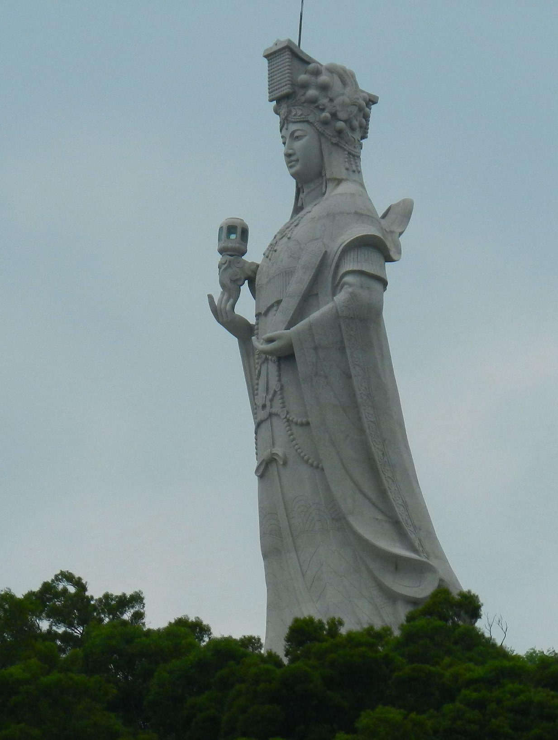
Gods and their methods
of intervention
Some Chinese gods might manifest themselves when coming to people’s rescue; others might send their assistants to help. Some could perform miraculous rescue or healing; others could act in ways that are more intelligible to humans, such as giving therapies like a medical professional.
Statue of Mazu at Mazugang, Nangan 南竿馬祖港媽祖像 (2012) © lienyuan lee, Wikipedia.com, under Creative Commons license 3.0.

